Slide 1
Multinational Capital Budgeting

Slide 2
Learning Objectives
Extend the domestic capital budgeting analysis to multinational capital budgeting.
Distinguish between the project viewpoint and the parent viewpoint of a potential foreign investment
Adjust the capital budgeting analysis of a foreign project for risk.
Compare the two approaches for foreign direct investment (DFI): cross-border M&As v.s. Greenfield investment.

Slide 3
Multinational Capital Budgeting
Multinational capital budgeting, like traditional domestic capital budgeting, focuses on the cash inflows and outflows associated with prospective long-term investment projects.
Capital budgeting for a foreign project uses the same theoretical framework as domestic capital budgeting.
The basic steps are:
Identify the initial capital invested or put at risk.
Estimate cash flows to be derived from the project over time, including an estimate of the terminal or salvage value of the investment.
Identify the appropriate discount rate to use in valuation
Apply traditional capital budgeting decision criteria such as NPV and IRR.

Slide 4
Capital budgeting for a foreign project is considerably more complex than the domestic case:
Parent cash flows must be distinguished from project cash flows.
The cash flows estimation are more complicated due to different tax system, legal and political constraints on the movement of funds, local business norms, differences in the way financial markets and institutions’ function, the form of financing, interactions among different subsidiaries, foreign exchange risk, and political risk.

Slide 5
Political Risk
Political risk is the possibility that political events in a particular country will (adversely) influence the economic well-being of a firm operating in that country.

Slide 6
Political Risk Mitigation
Stakeholder engagement
Prior and early engagement of key FDI stakeholder: host government, key political leader, and impacted communities
Use of domestic partners
Domestic partners could act as a potential “shield” to prevent government from implementing additional interference in the conduct of the business.
International investment agreements
An IIA spells put specific rights and responsibilities of both the foreign firm and government
Gradual investing
A MNE may follow a “prudent investment” policy, which invests capital in stages, and rely primarily upon retained earnings from the business itself for additional capital and expansion.
Blocked funds management
Analyze the effect of blocked funds, move funds through a variety of repositioning techniques, and reinvested in the local country in a manner that avoids deterioration in their real value
Dispute resolution
MNEs can also require all disputes to to go to international arbitration or to be resolved according to the rules of the International Centre for the Settlement of Investment Disputes (ICSID).
Political risk insurance
Governmental and private insurers offer policies designed to manage political risks, including the risk of expropriation and nationalization.
Berne Union, MIGA

Slide 7
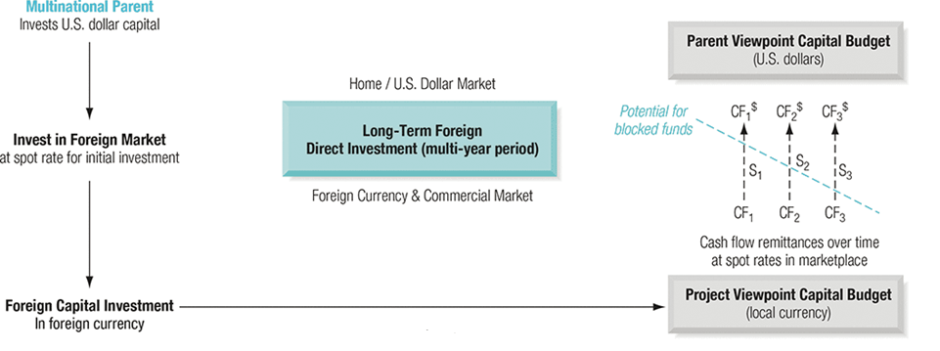
Project Versus Parent Valuation

Slide 8
A strong theoretical argument exists in favor of analyzing any foreign project from the viewpoint of the parent.
Cash flows to the parent are ultimately the basis for dividends to stockholders, reinvestment elsewhere in the world, repayment of corporate-wide debt, and other purposes that affect the firm’s many interest groups.
However, this viewpoint violates a cardinal concept of capital budgeting—that financial cash flows should not be mixed with operating cash flows.
Evaluation of a project from the local viewpoint serves some useful purposes:
MNEs should invest only if they can earn a risk-adjusted return greater than locally based competitors can earn on the same project, otherwise their stockholders would be better off buying shares in local firms
Most firms appear to evaluate foreign projects from both parent and project viewpoints (to obtain perspectives on NPV and the overall effect on consolidated earnings of the firm).
Local viewpoint should be subordinated to the parent’s viewpoint.

Slide 9
Capital Budgeting from the Parent’s Perspective: Example1
A U.S. MNC is considering a European opportunity. The size and timing of the after-tax cash flows are:
–€600
€200
€500
€300
0
1
2
3
The inflation rate in the euro zone is π€ = 3%, the inflation rate in dollars is π$ = 6%, and the WACC is 15%.
The current exchange rate is S₀($/€) = $1.25/€. Is this a good investment from the perspective of the U.S. shareholders?
Copyright © 2014 by the McGraw-Hill Companies, Inc. All rights reserved.
18-9

Slide 10
Capital Budgeting from the Parent’s Perspective: Example2
U.S. company invests in a project in Japan.
Expected future cash flows:
CF₀ = - ¥1,000 million. CF₁ = ¥500 million. CF₂ = ¥800 million.
Risk-adjusted cost of capital for a similar U.S. project = 10%.
Current spot exchange rate = 110 ¥/$.
U.S. government bond rates:
1-year bond = 2.0%
2-year bond = 2.8%
Japan government bond rates:
1-year bond = 0.05%
2-year bond = 0.26%

Slide 11
Driving forces behind the foreign direct investment
Gaining access to strategic proprietary assets.
Gaining market power and dominance.
Achieving synergies in local/global operations and across different industries.
Becoming larger, and then reaping the benefits of size in competition and negotiation.
Diversifying and spreading their risks wider.

Slide 12
Cross-border M&As compared to Greenfield investment
Pros
They tend to be quicker to achieve than starting from scratch.
International market imperfections may allow target firms to be undervalued.
Cons
Easy to pay too much.
Culture difference.
Potential host government interference.

Slide 13
Learning Objectives Revisit
Extend the domestic capital budgeting analysis to multinational capital budgeting.
Distinguish between the project viewpoint and the parent viewpoint of a potential foreign investment
Adjust the capital budgeting analysis of a foreign project for risk.
Compare the two approaches for foreign direct investment (DFI): cross-border M&As v.s. Greenfield investment.

